Slide 1


Slide 2

Advanced Networks
People's Democratic Republic of Algeria
Ministry of Higher Education and Scientific Research
Specialty: Computer Security
Prepared by: Dr, Elhachi Hana
Semester: 7 Credit: 5 Coefficient: 4

Slide 3
Chapters:
Introduction to Advanced Computer Networks
Network Security
Quality of Service (QoS)
Emerging Network Technologies
Advanced Routing and Switching
Network Management and Monitoring
Wireless and Mobile Networks
Case Studies and Practical Applications
Future Trends and Challenges

Slide 4
Objective: Overview of the module objectives, structure, and assessment criteria. Review of fundamental networking concepts and protocols. Introduction to advanced networking topics and their relevance in modern network environments.
Introduction to Advanced Computer Networks
Chapter 01

Slide 5
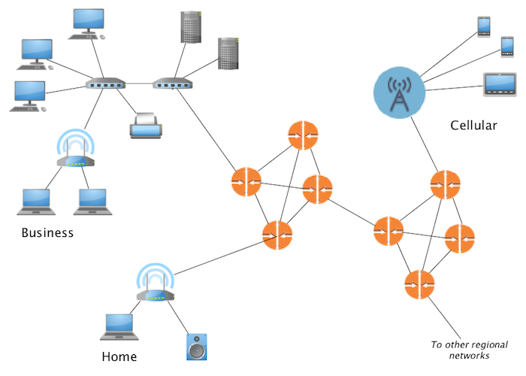
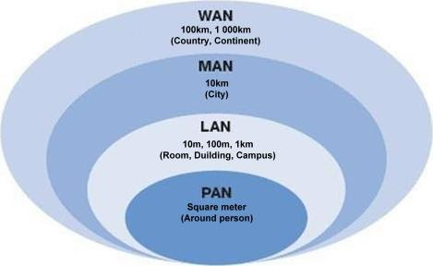
What is a Network?
A computer network is a group of interconnected devices (such as computers, servers, switches, routers, and IoT devices) that communicate with each other to share resources and exchange data. The practice of creating and managing these networks, known as networking, ensures reliable connectivity, security, and performance. Depending on their scope, networks can be classified as Local Area Networks (LAN), Wide Area Networks (WAN), Metropolitan Area Networks (MAN), or wireless networks such as Wi-Fi and cellular systems.
Chapter 01: Introduction to Advanced Computer Networks
Computer network components
Network classification

Slide 6
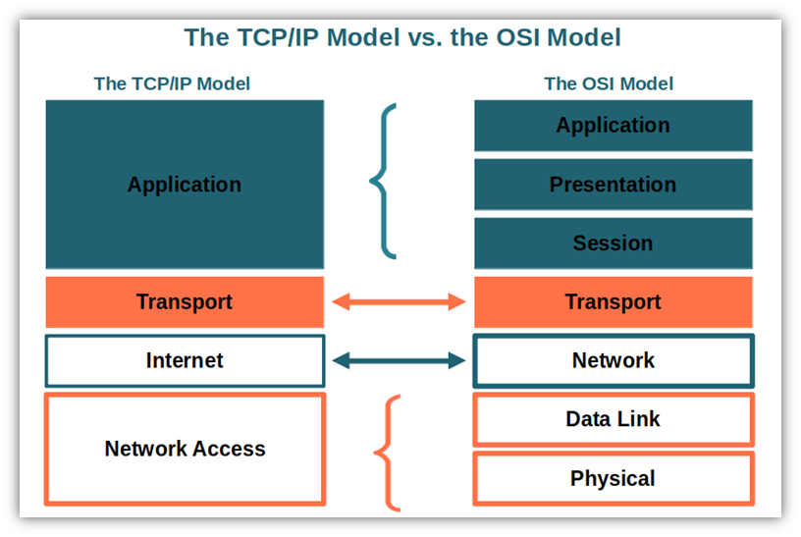
Reference Models
To handle network complexity, reference models are used to structure communication into well-defined layers, making it easier to understand, design, and troubleshoot networks. The two main models are the OSI model, which organizes communication into seven layers, and the TCP/IP model, which simplifies it into four layers. Both models describe how data flows from one device to another, ensuring interoperability between different systems and technologies.
Application Layer: Provides services and interfaces for end-user applications (e.g., HTTP/HTTPS, DNS).
Presentation Layer: Translates, encrypts, and compresses data to ensure proper format between systems (TLS / SSL, ASCII / EBCDIC).
Session Layer: Manages sessions and dialogs between applications, keeping track of connections (NetBIOS).
Transport Layer: Ensures reliable data delivery with error detection, flow control, and segmentation (e.g., TCP, UDP).
Network Layer: Handles logical addressing and routing to deliver packets across different networks (e.g., IP, OSPF).
Data Link Layer: Provides error detection and organizes data into frames for delivery within the same network (e.g., Ethernet, Wi-Fi).
Physical Layer: Transmits raw bits over physical media such as cables, radio waves, or fiber optics (SONET/SDH (fiber optics), RS-232 (serial communication)).
Chapter 01: Introduction to Advanced Computer Networks
Functions with protocol examples.

Slide 7
Application Protocols
Protocol | Function | How it Works
Hypertext Transfer Protocol / Secure (HTTP / HTTPS) | Enables web communication (client–server). | HTTP sends requests/responses in plaintext; HTTPS wraps HTTP in TLS for encryption and authentication.
Domain Name System (DNS) | Resolves domain names to IP addresses. | Uses hierarchical name servers (root → TLD → authoritative). Queries usually over UDP/53, zone transfers over TCP.
Transport Layer Security (TLS) | Secures communication with encryption & authentication. | Uses certificates (PKI) and symmetric/asymmetric cryptography to establish a secure session (handshake + data encryption).
American Standard Code for Information Interchange (ASCII coding) | Represents characters as numbers (0–127). | Maps each letter/symbol to a numeric binary code (e.g., “A” = 65). Ensures consistent text exchange across systems.
Network Basic Input/Output System (NetBIOS) | Provides legacy naming and session services in LANs. | Assigns names to devices and manages sessions over TCP/UDP ports (137–139). Replaced mostly by DNS.
Chapter 01: Introduction to Advanced Computer Networks

Slide 8
Transport & Network Protocols
Protocol | Function | How it Works
Transmission Control Protocol (TCP) | Reliable, connection-oriented transport. | Uses 3-way handshake, acknowledgments, sequencing, retransmission, and flow control to guarantee delivery.
User Datagram Protocol (UDP) | Fast, connectionless transport. | Sends datagrams without setup, no retransmission or ordering. Used in real-time apps (VoIP, video, gaming).
Internet Protocol (IP v4/v6) | Provides logical addressing and routing. | Encapsulates data into packets with source/destination IP. Routers forward based on routing tables.
Open Shortest Path First (OSPF) | Dynamic routing protocol (link-state). | Builds a complete topology map, uses Dijkstra’s algorithm to compute shortest paths. Organizes networks into hierarchical areas.
Chapter 01: Introduction to Advanced Computer Networks

Slide 9
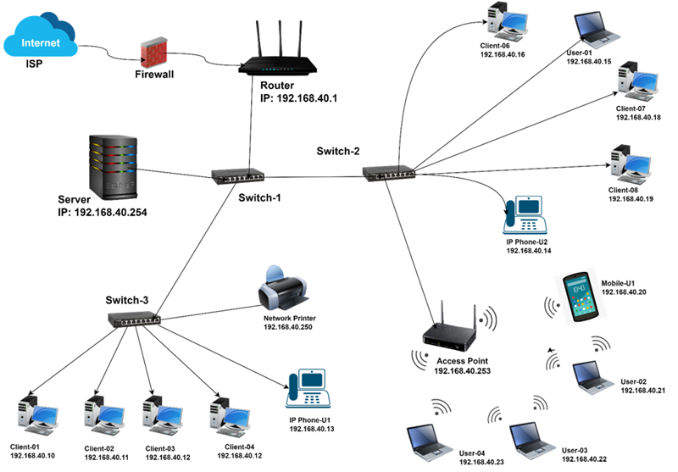
Network Devices
Hub A hub was an early device used to connect multiple devices in a LAN. Unlike switches, hubs simply broadcast all incoming data to every port. They are rarely used today because they are inefficient and insecure.
Switch A switch connects multiple devices (computers, servers, printers) within a Local Area Network (LAN). It operates by learning and using MAC addresses to forward frames only to the intended recipient, unlike hubs that broadcast to all devices. Modern switches also support advanced features like VLANs, link aggregation, and sometimes even routing.
Router A router connects different networks together, such as your home network to the Internet. It makes forwarding decisions based on IP addresses and relies on routing protocols like OSPF or BGP to determine the best path for data. Routers can also provide NAT (Network Address Translation), DHCP services, and basic firewalling.
Chapter 01: Introduction to Advanced Computer Networks

Slide 10
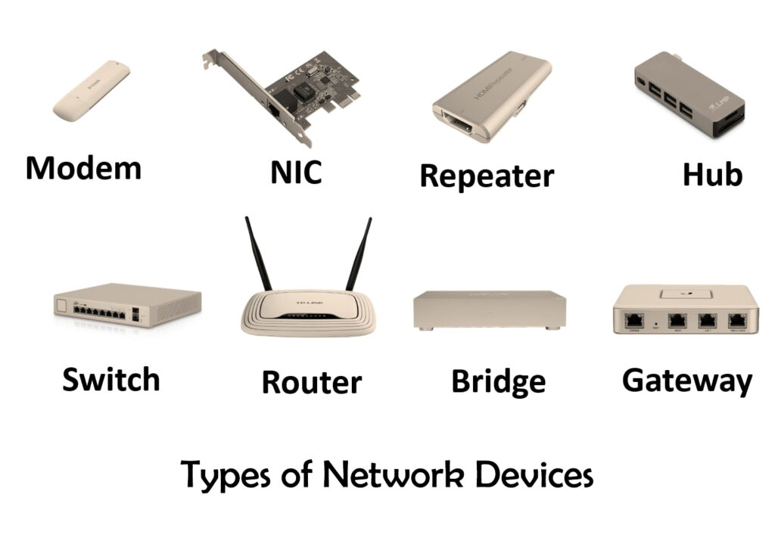
Network Devices
Access Point (AP)
An access point provides wireless connectivity, allowing devices like laptops and smartphones to join a network without cables.
It acts as a bridge between Wi-Fi clients and the wired LAN.
Enterprise APs often include features such as user authentication, roaming support, and centralized management.
Firewall
A firewall protects a network by controlling the traffic that enters or leaves it.
It enforces security policies by allowing or blocking packets based on rules.
Types include packet-filtering firewalls, stateful firewalls, and next-generation firewalls (NGFW) with intrusion detection and deep packet inspection.
Gateway
A gateway connects networks that use different protocols or architectures.
It translates data between systems (e.g., a VoIP gateway that converts phone calls between IP and traditional phone networks).
Often used in IoT and industrial networks for interoperability.
Chapter 01: Introduction to Advanced Computer Networks

Slide 11
What is Advanced Networking?
Advanced Networking refers to the study and implementation of modern and sophisticated networking technologies, protocols, and architectures that go beyond basic connectivity.
While traditional networking focuses on establishing communication between devices (using IP, routing, and switching), advanced networking emphasizes optimizing, securing, and automating these communications to meet the complex demands of today’s digital environments.
It involves technologies and concepts such as:
Network Security (firewalls, IDS/IPS, encryption)
Quality of Service (QoS) for performance assurance
Software-Defined Networking (SDN) and Network Function Virtualization (NFV)
Wireless and Mobile Networks (4G/5G, IoT)
Advanced routing and switching (BGP, OSPF, VLANs)
Network management and monitoring tools (SNMP, NetFlow)
Chapter 01: Introduction to Advanced Computer Networks

Slide 12
Why Advanced Networking
Increased Complexity of Modern Networks
Today’s networks integrate wired, wireless, cloud, and virtualized components.
Managing and securing such environments requires advanced protocols and automation tools.
Security Challenges
As cyber threats evolve, network professionals must understand advanced mechanisms (e.g., encryption, VPNs, IDS/IPS) to protect data in transit.
Performance and QoS Requirements
Applications like video conferencing, online gaming, and telemedicine demand low latency, high bandwidth, and reliable performance, all managed via advanced QoS techniques.
Scalability and Virtualization
Cloud data centers and virtual networks (via SDN/NFV) enable dynamic resource allocation, essential for large-scale systems and enterprise operations.
Support for Emerging Technologies
Advanced networks are the backbone of 5G, IoT, AI-driven networking, and edge computing, all of which rely on flexible, intelligent network infrastructures.
Automation and Management Efficiency
Advanced networking introduces programmable networks (e.g., SDN) that simplify configuration, reduce human error, and increase adaptability.
Chapter 01: Introduction to Advanced Computer Networks

Slide 13
Content: * Threats, vulnerabilities, and attacks in computer networks. * Cryptography and encryption techniques for securing data transmission. * Firewalls, intrusion detection systems, and other security mechanisms. * Secure network design principles and best practices.
Network Security
Chapter 02

Slide 14
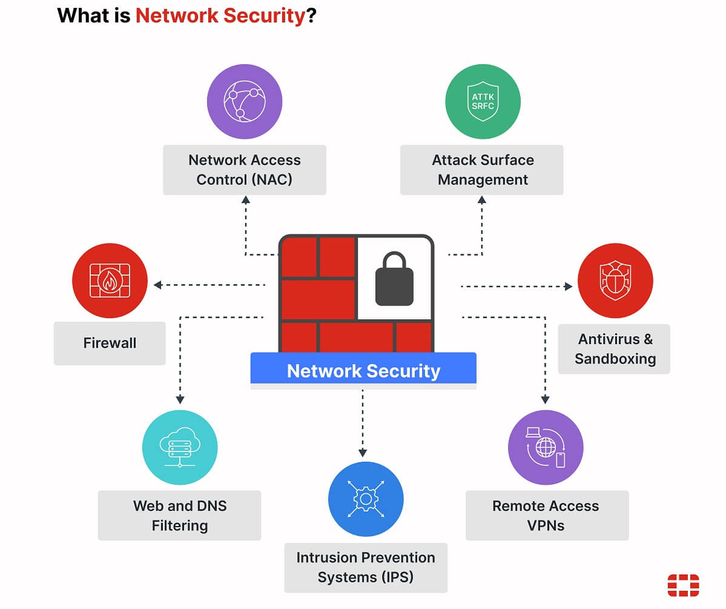
What Is Network Security?
It refers to the policies, technologies, and practices designed to protect data and resources from unauthorized access, misuse, or attacks.
It involves both hardware and software solutions, including firewalls, intrusion prevention systems, and secure protocols.
Core principles include:
Confidentiality: Only authorized users can access data.
Integrity: Data remains accurate and unchanged.
Availability: Systems and information are accessible when needed.
Authentication & Authorization: Verify identity and control access.
Accountability: Actions can be traced and audited.

Slide 15



Threats, Vulnerabilities, and Attacks
A threat is any potential event, action, or circumstance that can cause harm to a network, system, or organization by exploiting a vulnerability. In networking, threats may target confidentiality (data theft), integrity (data modification), or availability (service disruption).
A vulnerability is a weakness, flaw, or gap in the design, implementation, or configuration of a system that could be exploited by a threat. Vulnerabilities can exist in hardware, software, network configurations, or human behavior (e.g., poor password practices).
An attack (risk) is the deliberate action taken by a threat actor to exploit a vulnerability and compromise the target system’s security. Attacks can aim to steal data, disrupt services, or gain unauthorized control over systems.

Slide 16
Common Network Threats, Attacks, and Vulnerabilities
Type | Category | Description | Examples
Threat | Internal Threats | Originate inside the organization; may result from intentional misuse or human error. | Malicious insider, careless employee, data leakage.
 | External Threats | Come from outside sources attempting to compromise or disrupt the network. | Hackers, competitors, cybercriminals
 | Environmental Threats | Non-human factors that threaten system availability. | Power outage, hardware failure, fire, flood.
Vulnerability | System & Configuration Weaknesses | Flaws in design, configuration, or management that can be exploited. | Unpatched OS, weak passwords, open ports, default credentials.
 | Protocol Weaknesses | Insecure or outdated communication standards. | FTP, Telnet, HTTP (unencrypted protocols).
 | Physical & Environmental Weaknesses | Inadequate physical protections or environmental safeguards. | Unsecured server rooms, lack of backup power, overheating.
Chapter 01: Introduction to Advanced Computer Networks

Slide 17
Common Network Threats, Attacks, and Vulnerabilities
Type | Category | Description | Examples
Attack | Active Attacks | Attempt to alter or disrupt network operations and data integrity. | DoS/DDoS, spoofing, man-in-the-middle (MITM), session hijacking.
 | Passive Attacks | Aim to monitor, capture, or analyze network traffic without changing it. | Packet sniffing, eavesdropping, traffic analysis.
 | Network Attacks | Target the infrastructure or protocols to gain control or cause disruption. | IP/MAC spoofing, port scanning, routing attacks (e.g., OSPF poisoning).
 | Malware-Based Attacks | Use malicious software to damage, steal, or control data/systems. | Viruses, worms, Trojans, ransomware, spyware.
 | Human-Centric Attacks | Exploit human trust or behavior rather than technical flaws. | Phishing, social engineering, shoulder surfing.
Chapter 01: Introduction to Advanced Computer Networks

Slide 18
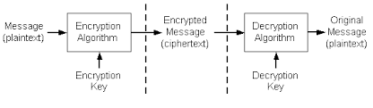
What Is Cryptography?
Key Concepts
Plaintext: The original readable message or data.
Ciphertext: The encrypted, unreadable form of the plaintext.
Key: A secret value used by an algorithm to encrypt or decrypt data.
Encryption: The process of converting plaintext into ciphertext.
Decryption: The process of converting ciphertext back into readable plaintext.
Algorithm (Cipher): A mathematical function that performs encryption or decryption using a key.
Cryptography is the science and art of securing information by transforming it into a form that is unreadable to unauthorized users. It ensures that even if data is intercepted or accessed by an attacker, it cannot be understood or altered without the proper cryptographic keys.

Slide 19
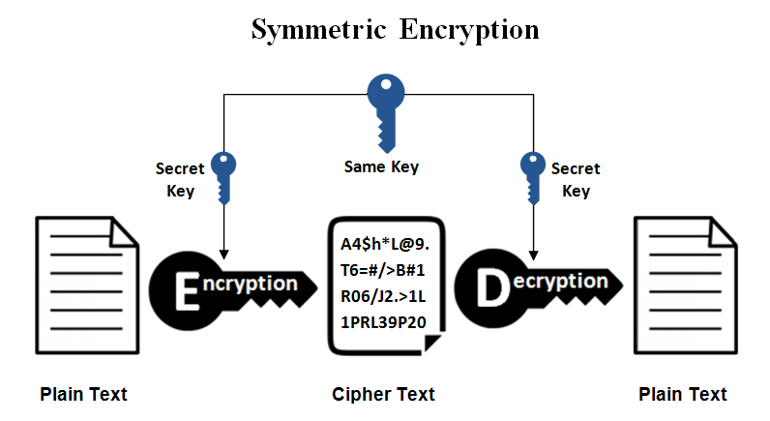
Cryptographic Techniques
Symmetric encryption (secret-key encryption like AES, DES, and chacha20) is a cryptographic technique where the same key is used for both encryption and decryption. It is the fastest and most efficient form of encryption, commonly used for securing large volumes of data in modern networks.
The sender and receiver share a single secret key in advance.
The sender uses this key and an encryption algorithm to convert plaintext into ciphertext.
The receiver uses the same key and a decryption algorithm to recover the original plaintext.
Symmetric Encryption
Asymmetric Encryption
Hashing
Digital Signatures
Hybrid Encryption

Slide 20
Advantages and Disadvantages of Symmetric Encryption
Advantages:
High speed: Efficient for encrypting large data volumes.
Low computational cost: Ideal for hardware or software implementation.
Strong security (with modern algorithms like AES).
Disadvantages
Key distribution problem: Both parties must securely share the same key.
Scalability issue: For n users, you need n(n−1)/2 unique keys.
No built-in authentication: It only ensures confidentiality — not identity verification.

Slide 21
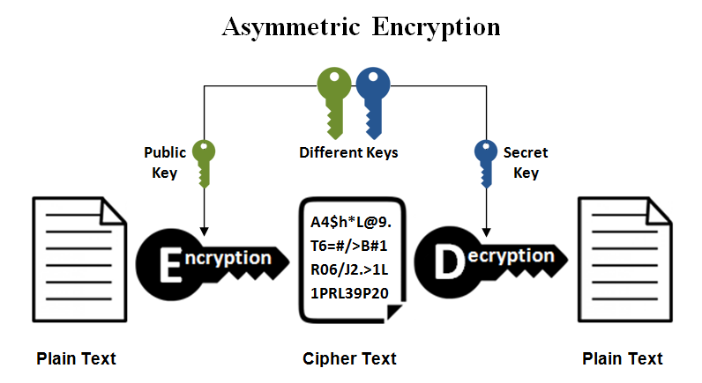
Cryptographic Techniques
Asymmetric encryption, like RSA, is a cryptographic technique that uses two different keys (a public key and a private key) for secure communication. The public key is shared openly and used for encryption. The private key is kept secret and used for decryption. The two keys are mathematically related, but it’s computationally infeasible to derive one from the other.
Each user generates a key pair (public + private).
The public key is distributed to others.
When someone wants to send you a secure message:
They encrypt it using your public key.
You decrypt it using your private key.
4. Only you private key can decrypt data encrypted with your public key.
Symmetric Encryption
Asymmetric Encryption
Hashing
Digital Signatures
Hybrid Encryption

Slide 22
Advantages and Disadvantages of Symmetric Encryption
Advantages
Solves the key distribution problem (no need to share secret keys beforehand).
Enables authentication and non-repudiation (when combined with digital signatures).
Supports secure key exchange for symmetric encryption.
Disadvantages
Slower than symmetric encryption due to complex mathematics.
Not suitable for large data encryption — typically used only to exchange symmetric keys.
Relies on trust infrastructure (e.g., certificates, PKI).
Vulnerable to private key compromise — if the private key is stolen, security is lost.

Slide 23
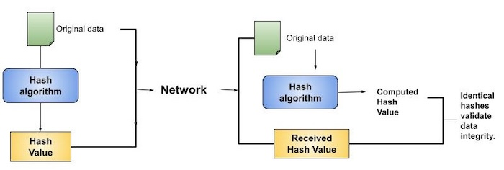
Cryptographic Techniques
Hashing is a mathematical process that transforms an input message of arbitrary length (text, file, password, etc.) into a fixed-size string of characters called a hash value, digest, or message digest, using a hash function.
It is a one-way and deterministic operation:
One-way means it is computationally infeasible to reverse the process — you cannot reconstruct the original input from its hash value.
Deterministic means the same input always produces the same hash output.
The hash function performs a series of logical, bitwise, and modular arithmetic operations on blocks of input data, generating a fixed-size output (for example, 256 bits for SHA-256), regardless of how large or small the input is.
“Hashing does not provide confidentiality, but it ensures integrity (meaning that even the smallest change in input data (like changing one bit) results in a completely different hash value.”
Symmetric Encryption
Asymmetric Encryption
Hashing
Digital Signatures
Hybrid Encryption

Slide 24
Why Hashing Is Still a Type of Security (Even Without Confidentiality)
Hashing does not hide information (so it doesn’t provide confidentiality), but it protects the trustworthiness and authenticity of data, which are other pillars of security.
In cybersecurity, we often talk about the CIA triad (Confidentiality, Integrity, and Availability).
Hashing directly supports the I: Integrity part.
Integrity as a Security Goal:
Integrity ensures that data has not been changed, deleted, or tampered with, whether accidentally (e.g., transmission error) or intentionally (e.g., attacker modification).
If integrity is broken:
A message, file, or transaction could be altered.
Even encrypted data could become invalid or dangerous.
Hashing detects such modifications instantly. That’s why it’s a core security mechanism, even without confidentiality.

Slide 25
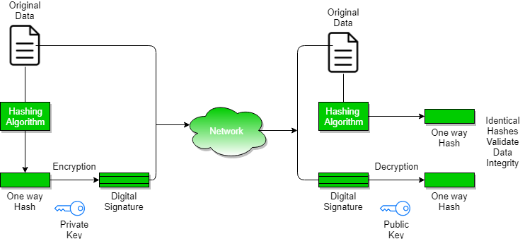
Cryptographic Techniques
A digital signature is a cryptographic mechanism that provides authentication, integrity, and non-repudiation for digital data.
It works like an electronic version of a handwritten signature ensuring that:
The message really came from the claimed sender (authentication),
The message has not been altered (integrity), and
The sender cannot deny having sent it (non-repudiation).
Digital signatures are based on asymmetric cryptography and hashing.
Symmetric Encryption
Asymmetric Encryption
Hashing
Digital Signatures
Hybrid Encryption

Slide 26
Digital Signature Step by Step
Signing Process (Sender’s Side)
The sender computes a hash of the message (e.g., SHA-256).
The hash (not the message itself) is encrypted using the sender’s private key.
This encrypted hash is the digital signature.
The signature is sent along with the message.
2. Verification Process (Receiver’s Side)
The receiver computes a hash of the received message.
The receiver decrypts the digital signature using the sender’s public key, obtaining the sender’s original hash.
The receiver compares the two hashes:
If they match → The message is authentic and unchanged.
If they differ → The message was altered or not from the claimed sender.

Slide 27
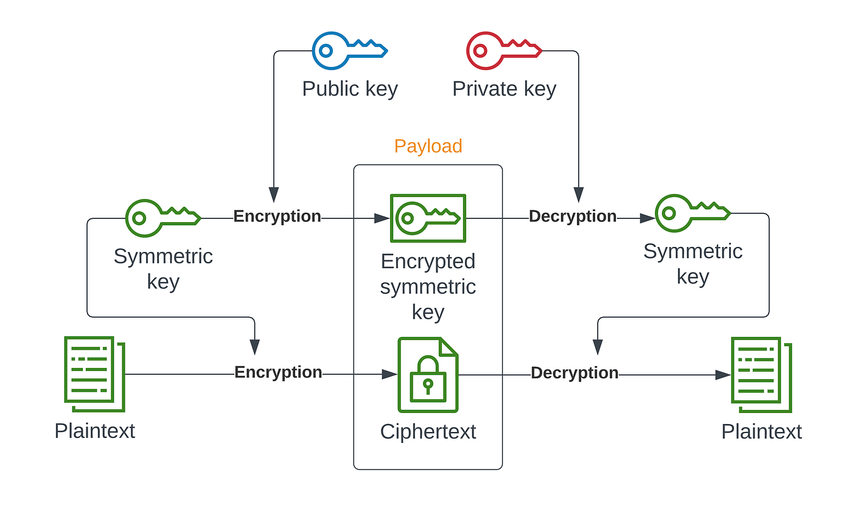
Cryptographic Techniques
Hybrid encryption is a cryptographic approach that combines symmetric and asymmetric encryption to take advantage of the strengths of both techniques, the speed and efficiency of symmetric encryption and the secure key exchange of asymmetric encryption.
Symmetric Encryption
Asymmetric Encryption
Hashing
Digital Signatures
Hybrid Encryption

Slide 28
Hybrid Encryption Step by Step
Key Generation:
The sender generates a random symmetric key (also called a session key).
This key will be used to encrypt the actual data using a fast symmetric algorithm (e.g., AES).
Data Encryption:
The plaintext data (file, message, etc.) is encrypted with the symmetric key, producing ciphertext.
This ensures fast and efficient data encryption, even for large files.
Key Encryption:
The symmetric key itself is then encrypted using the receiver’s public key (asymmetric encryption, e.g., RSA).
Only the receiver can decrypt this key using their private key, ensuring secure key exchange.
Transmission:
The sender transmits both:
The encrypted symmetric key, and
The encrypted data (ciphertext) to the receiver.
Decryption (Receiver Side):
The receiver first decrypts the symmetric key using their private key.
Then, the decrypted symmetric key is used to decrypt the data back into plaintext.

Slide 29
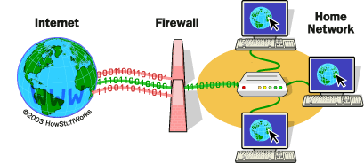
Firewall and its Functionality
A firewall is a network security device or software that monitors and controls incoming and outgoing traffic based on predefined security rules. It acts as a barrier between trusted internal networks and untrusted external networks (like the Internet).
Primary Functionality:
To manage traffic flow by permitting or denying packets based on criteria such as IP addresses, port numbers, and transport protocols.
To implement security policies that safeguard the network against unauthorized access attempts.

Slide 30
Firewall types
It is a basic firewall operates primarily at Layer 3 (Network Layer) of the OSI model, analyzing packet headers to enforce security policies. It focuses on attributes such as source and destination IP addresses, port numbers, and protocol types.
Operational Mechanism:
Upon transmission, each packet undergoes scrutiny against a predefined set of rules encapsulated in an Access Control List (ACL).
If a packet adheres to an 'allow' rule, it is permitted to proceed; if not, the packet is discarded.
Benefits:
The firewall's simplicity ensures rapid processing.
Its efficiency yields low overhead on system resources.
Limitations:
The firewall operates solely on header information, lacking the capacity to perform deep packet inspection.
It cannot maintain stateful connection tracking, which poses risks of permitting spoofed or fragmented packets.
As a stateless mechanism, it offers no defense against application-layer threats such as malware or SQL injection attacks.
Packet-Filtering Firewall
Stateful Inspection Firewall
Application-Level Firewall (Proxy Firewall)
Next-Generation Firewall (NGFW)

Slide 31
Firewall types
Operation Principle
A stateful firewall operates by maintaining a state table to monitor active connections, ensuring that only packets belonging to established sessions are permitted through.
Mechanism
Upon initiation of a connection, such as a TCP session, the firewall logs critical session parameters, including IP addresses, port numbers, and sequence numbers. It employs this information to verify the legitimacy of incoming packets against known sessions.
This methodology effectively blocks unauthorized packets that attempt to masquerade as legitimate traffic.
Benefits
Stateful firewalls offer enhanced security over stateless packet filtering mechanisms by providing context for each packet. They are capable of recognizing and intercepting anomalous TCP handshake processes, further strengthening network defenses.
Limitations
However, they incur slightly increased resource overhead due to the necessity of state tracking. Additionally, stateful firewalls do not offer the capability to inspect application-layer data, which can limit their effectiveness against certain types of threats.
Packet-Filtering Firewall
Stateful Inspection Firewall
Application-Level Firewall (Proxy Firewall)
Next-Generation Firewall (NGFW)

Slide 32
Firewall types
A proxy firewall functions as an intermediary layer between clients and external networks, facilitating controlled communication. Rather than allowing direct traffic flow, it intercepts client requests, thoroughly inspects them, and relays them to the intended destinations.
Operational Overview
1. Client Connection: The client establishes a connection to the proxy firewall (e.g., an HTTP proxy).
2. Content Examination: The proxy conducts a detailed analysis of the incoming requests, evaluating components such as URLs and commands for potential threats.
3. New Connection Initiation: Upon validating the safety of the requests, the proxy initiates a fresh connection to the target server, effectively representing the client's request.
Benefits
- Enables in-depth traffic content inspection, providing enhanced security and compliance capabilities.
- Capable of caching responses, which significantly improves response times for repeated requests.
- Masks internal IP addresses, providing a layer of anonymity and simulating a form of Network Address Translation (NAT).
Limitations
- Content inspection can introduce additional latency, potentially impacting user experience.
- Each protocol (e.g., HTTP, FTP, etc.) requires a dedicated proxy solution, complicating deployment and management.
Packet-Filtering Firewall
Stateful Inspection Firewall
Application-Level Firewall (Proxy Firewall)
Next-Generation Firewall (NGFW)

Slide 33
Firewall types
Next-Generation Firewalls (NGFW) extend the capabilities of traditional firewalls by incorporating advanced security functions, including:
- Deep Packet Inspection (DPI): Enables thorough analysis of packet data beyond header information.
- Intrusion Prevention Systems (IPS): Actively identifies and mitigates known vulnerabilities and threats in real-time.
- Application Awareness and Control: Grants the ability to discern and manage application-specific traffic irrespective of the transmitting port.
- SSL/TLS Decryption: Facilitates inspection of encrypted traffic to ensure malicious content isn't overlooked.
- Malware Detection and Sandboxing**: Detects and analyzes potentially harmful code in a safe environment before it can impact the network.
Operational Mechanism:
NGFWs analyze traffic at the application layer, employing sophisticated techniques that identify and manage specific applications (such as Skype or YouTube) irrespective of their respective ports. This enables the firewall to apply customized policies that either block or prioritize traffic based on content, user identity, or organizational policies.
Packet-Filtering Firewall
Stateful Inspection Firewall
Application-Level Firewall (Proxy Firewall)
Next-Generation Firewall (NGFW)

Slide 34
Firewall types
Benefits
- Provides comprehensive protection against contemporary cyber threats.
- Integrates a suite of security features into a single platform, streamlining management.
- Highly suitable for enterprise-level networks that require robust security postures.
Limitations
- Typically entails higher costs and demands more resources for deployment.
- Configuration and ongoing maintenance can be complex, necessitating skilled personnel.
Packet-Filtering Firewall
Stateful Inspection Firewall
Application-Level Firewall (Proxy Firewall)
Next-Generation Firewall (NGFW)

Slide 35
Firewall types
Firewalls have evolved from simple packet filters to intelligent, application-aware systems. Modern networks rely on stateful, proxy, and next-generation firewalls to provide layered protection across multiple OSI layers.
Type | Layer (OSI) | Main Function | Key Advantage | Main Limitation
Packet Filtering | 3 | Checks IP, port, protocol | Simple, fast | No payload inspection
Stateful Inspection | 3–4 | Tracks session states | More secure | Limited to transport layer
Circuit-Level Gateway | 5 | Verifies session establishment | Validates sessions | No deep inspection
Proxy Firewall | 7 | Filters application data | Deep inspection | Slower, per-protocol
NGFW | 3–7 | DPI + IPS + App Control | All-in-one protection | Expensive, complex

Slide 36
Intrusion Detection System (IDS)
Definition:
An Intrusion Detection System (IDS) is a comprehensive security framework designed to monitor and analyze both network and system activities in order to identify suspicious behavior, security breaches, or confirmed attack patterns. The primary purpose of an IDS is to enhance the security posture of an organization by promptly detecting potential threats.
Functionality:
-Detection of Unauthorized Access: The IDS continuously scans for attempts to gain unauthorized entry into systems, ensuring that any illicit access is flagged immediately.
- Policy Violation Alerts: The system evaluates activities against established security policies, alerting administrators when violations occur, such as improper access to sensitive data or unauthorized changes to configurations.
- Anomaly Detection: By monitoring system performance metrics, the IDS can identify deviations from normal operation, signaling potential intrusions or system malfunctions.
- Alert Mechanism: When the IDS identifies potential threats, it generates alerts for system administrators, providing them with timely notifications to investigate and respond to incidents.
- Non-Intrusive Monitoring: Unlike Intrusion Prevention Systems (IPS), IDS does not take active measures to block or prevent traffic; instead, it operates in a passive mode, focusing solely on monitoring, logging, and reporting.

Slide 37
IDS Types and Detection Techniques
IDS Types:
Network-based IDS (NIDS): This type of system monitors data traffic flowing across the network infrastructure. NIDS can analyze packets, inspect communication patterns, and detect potential threats by assessing the entirety of the network's traffic in real-time.
Host-based IDS (HIDS): HIDS focuses on monitoring the activities and events occurring on a specific host or server. This includes tracking file integrity, system calls, and processes, thereby providing a granular level of monitoring for critical servers and endpoints.
Detection Techniques:
Signature-based Detection: This approach involves comparing network traffic against a database of known attack signatures or patterns. Similar to antivirus software, it relies on established threat definitions to identify malicious traffic. While effective for known threats, it may miss newly developed or sophisticated attacks that do not match existing signatures.
Anomaly-based Detection: Utilizing advanced statistical models, algorithms, or machine learning techniques, this method establishes a baseline of normal behavior for systems or networks. It then detects unusual activity that deviates from this baseline, allowing for the identification of previously unknown threats and zero-day vulnerabilities.

Slide 38
Intrusion Prevention System (IPS)
Definition:
An Intrusion Prevention System (IPS) is an advanced security mechanism designed to enhance network defense by not only detecting potential threats but also proactively blocking or mitigating them in real-time. Unlike an Intrusion Detection System (IDS), which solely monitors and alerts on suspicious activity without taking action, an IPS takes immediate countermeasures to safeguard network integrity.
Function:
- Real-Time Network Monitoring: An IPS continuously analyzes network traffic streams to identify patterns that may suggest malicious intent, allowing for rapid detection of anomalies.
- Packet Inspection: It utilizes deep packet inspection (DPI) techniques to scrutinize the contents of data packets, discerning between benign and harmful traffic. Malicious packets can be identified based on predefined signatures or behavioral analysis.
- Automated Response: Upon detecting an attack, the IPS can take predefined actions such as dropping malicious packets, resetting connections, or even blocking the offending IP addresses to prevent further incidents.
- Integration with Next-Generation Firewalls (NGFW): Often, IPS functionality is embedded within Next-Generation Firewalls, providing a more cohesive and comprehensive security solution. This integration allows for more sophisticated traffic filtering and threat detection, combining the features of traditional firewalls with advanced malware detection.

Slide 39
Other Network Defense Mechanisms
Network Access Control (NAC): Ensures only authenticated and compliant devices can connect to the network.
Virtual Private Network (VPN): Encrypts communication between remote users and the internal network, ensuring confidentiality and integrity over public links.
Demilitarized Zone (DMZ): A separate subnetwork that isolates public-facing services (like web servers) from the internal LAN — limits exposure if a server is compromised.
Antivirus and Anti-Malware Gateways: Inspect files and emails for malicious content before allowing them into the network.
Security Information and Event Management (SIEM): Collects and analyzes logs from multiple security systems to detect complex or correlated attacks.
In a secure network, multiple defense mechanisms work together in a layered approach. Firewalls filter traffic and block unauthorized access, while IDS/IPS detect and prevent intrusions in real time. NAC and VPNs ensure secure and trusted connections, and a DMZ isolates public services from the internal network. Finally, SIEM systems centralize monitoring and alerting, providing complete visibility and faster incident response.

Slide 40
Secure Network Design Principles - Best Practices -
Defense in Depth: Multiple layers of protection.
Least Privilege: Limit access rights.
Segmentation: Isolate sensitive zones (e.g., DMZ, VLANs).
Strong Access Control: MFA, RBAC, NAC.
Encryption: Protect data in transit and at rest.
System Hardening: Disable unused ports/services.
Monitoring: Log and analyze all critical activities.
Patch Management: Keep systems up to date.
Resilience: Redundant paths and failover mechanisms.
Security by Design: Integrate protection from the start.

Slide 41
Secure Network Design Principles -Best Practices-
Principle | Description
Defense in Depth | Use multiple layers of security to protect the network even if one layer fails.
Least Privilege | Grant users and systems only the access rights necessary to perform their specific tasks.
Segmentation and Isolation | Divide the network into smaller subnets or VLANs to contain traffic and limit the spread of attacks.
Secure Access Control | Enforce strong authentication (e.g., MFA) and authorization (e.g., RBAC, NAC) to manage who can access what.
Encryption and Data Protection | Encrypt data both in transit (TLS, VPN) and at rest (AES) to maintain confidentiality and integrity.
Secure Configuration and Hardening | Disable unused services, close unnecessary ports, and replace default credentials to reduce exposure.
Monitoring and Logging | Continuously monitor traffic and log critical events using SIEM systems for detection and forensic analysis.
Regular Updates and Patch Management | Keep software, firmware, and systems up to date to close vulnerabilities before they are exploited.
Redundancy and Resilience | Use backup links, redundant hardware, and failover systems to ensure availability and reliability.
Security by Design | Integrate security considerations from the start of network planning and throughout its lifecycle.

Slide 42
Quality of Service (QoS)
Chapter 03
By the end of this chapter, students will be able to:
Define QoS and explain why it’s needed in modern networks.
Identify and measure QoS performance metrics (delay, jitter, loss, bandwidth).
Understand QoS models and mechanisms used in enterprise networks.
Configure and verify QoS tools (classification, marking, queuing, policing).
Evaluate QoS strategies in different environments.

Slide 43
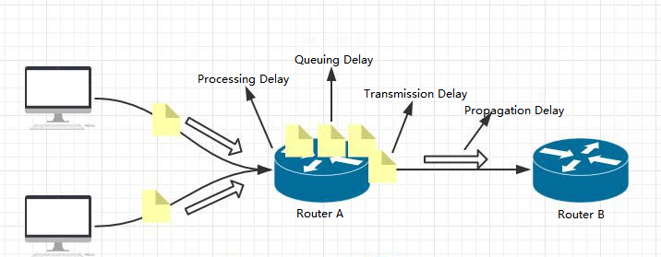
Quality of Service (QoS)
Definition:
Quality of Service (QoS) refers to a suite of technologies and techniques in networking that enables the management and prioritization of data traffic. It is essential for ensuring that different types of data flows receive the appropriate levels of bandwidth, delay, jitter, and packet loss control. QoS allows networks to differentiate between various applications and user requirements, thereby providing a more predictable performance across diverse traffic types.
Why QoS Matters:
Modern networks handle multiple traffic types (voice, video, data, IoT).
Real-time applications (VoIP, video conferencing) need guaranteed delivery.
Without QoS, all traffic is treated equally — causing delays and poor performance.
Jitter
2
4
1
2Gbps
4Gbps
Packet Loss

Slide 44
QoS Performance Metrics
Metric | Definition | Effect of Poor Value
Bandwidth | Capacity of a link (bps) | Congestion, slow transmission
Delay (Latency) | Time for a packet to reach destination | Echo in calls, video lag
Jitter | Variation in delay between packets | Choppy voice or video
Packet Loss | % of packets not delivered | Missing frames, distorted audio
Reliability | Network’s ability to maintain connection | Service interruptions
QoS relies on specific measurable network performance metrics:

Slide 45
Quality of Service (QoS)
Jitter
2
4
1
2Gbps
4Gbps
Packet Loss

Slide 46
QoS Tools and Mechanisms
Definition: QoS tools are the set of mechanisms used by network devices (routers, switches) to control traffic behavior — by classifying, prioritizing, scheduling, delaying, or discarding packets — in order to meet specific performance requirements (latency, jitter, loss).
Main Goal: Ensure that critical applications (e.g., voice, video conferencing, or control signals) receive better service than non-critical traffic (e.g., email, file downloads).
QoS Tools and Mechanisms
Classification and Marking
Queuing (Congestion Management)
Congestion Avoidance
Traffic Policing
Traffic Shaping
Link Efficiency Mechanisms (LEM)

Slide 47
Main QoS Mechanisms
Classification
Purpose: Identify and group packets based on specific characteristics.
How it works: When a packet arrives at a router or switch, the device examines packet headers to determine the type of traffic and the application it belongs to.
Source/destination IP address
Protocol type (TCP/UDP)
Port number (e.g., 80 for HTTP, 5060 for SIP)
Packets are placed into traffic classes (e.g., Voice, Video, Best Effort, Background).
Marking
Purpose: Tag packets with a priority value that other network devices can recognize and act upon.
Where it happens: Usually at the network edge — as close as possible to the traffic source (e.g., access switch or router).
How it works: The device sets a value in a specific header field:
Layer 2: CoS (Class of Service) — uses the 3-bit priority field in IEEE 802.1Q VLAN tag.
Layer 3: DSCP (Differentiated Services Code Point) — uses 6 bits in the IP header.
Layer 3: IP Precedence (older 3-bit field before DSCP).
Classification and Marking
Queuing (Scheduling techniques)
Congestion Avoidance
Traffic Policing
Traffic Shaping
Link Efficiency Mechanisms (LEM)

Slide 48
Main QoS Mechanisms
Purpose:
When multiple packets compete for the same output interface, queuing mechanisms decide which packet leaves next — ensuring critical traffic is not delayed or dropped.
How it works:
Each router interface has buffers (queues). When congestion occurs, packets are placed into these queues based on their priority class.
Example in practice:
Imagine a link carrying:
Voice (priority queue)
Video (medium class)
Web traffic (best effort)
During congestion:
Voice traffic always leaves first (low delay, low jitter).
Video traffic gets the next priority.
Web traffic waits or is dropped if necessary
Classification and Marking
Queuing (Scheduling techniques)
Congestion Avoidance
Traffic Policing
Traffic Shaping
Link Efficiency Mechanisms (LEM)

Slide 49
Main QoS Mechanisms
Algorithm | Description | Use Case
FIFO (First In, First Out) | Simplest method — packets are processed in arrival order. | Not suitable for real-time applications.
PQ (Priority Queuing) | Packets are divided into priority queues (high, medium, low); higher ones always transmitted first. | VoIP, real-time apps.
WFQ (Weighted Fair Queuing) | Dynamically assigns bandwidth fairly based on weight (importance). | Balanced environments with mixed traffic.
CBWFQ (Class-Based WFQ) | Admin defines specific classes and assigns bandwidth shares explicitly. | Enterprise WAN links.
LLQ (Low-Latency Queuing) | Combines CBWFQ and PQ; offers strict priority for delay-sensitive traffic like voice. | VoIP and interactive video.
Classification and Marking
Queuing (Scheduling techniques)
Congestion Avoidance
Traffic Policing
Traffic Shaping
Link Efficiency Mechanisms (LEM)

Slide 50
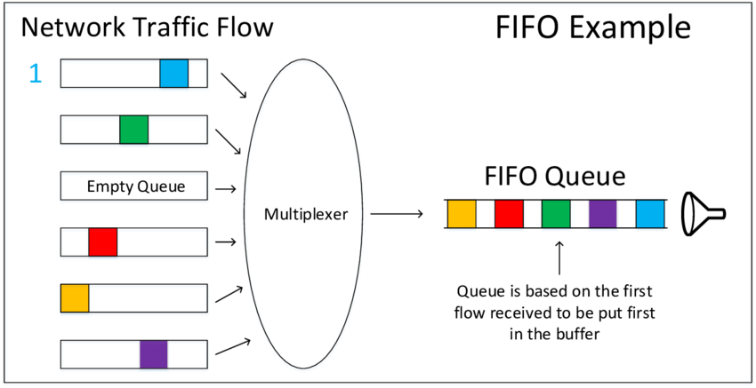
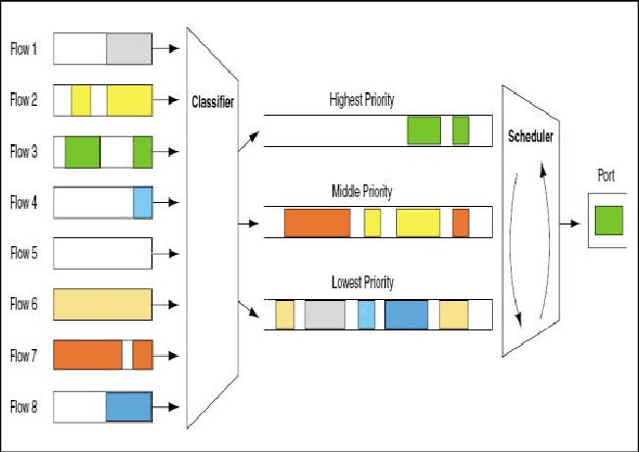
Main QoS Mechanisms
FIFO (First In, First Out)
PQ (Priority Queuing)
Classification and Marking
Queuing (Scheduling techniques)
Congestion Avoidance
Traffic Policing
Traffic Shaping
Link Efficiency Mechanisms (LEM)

Slide 51
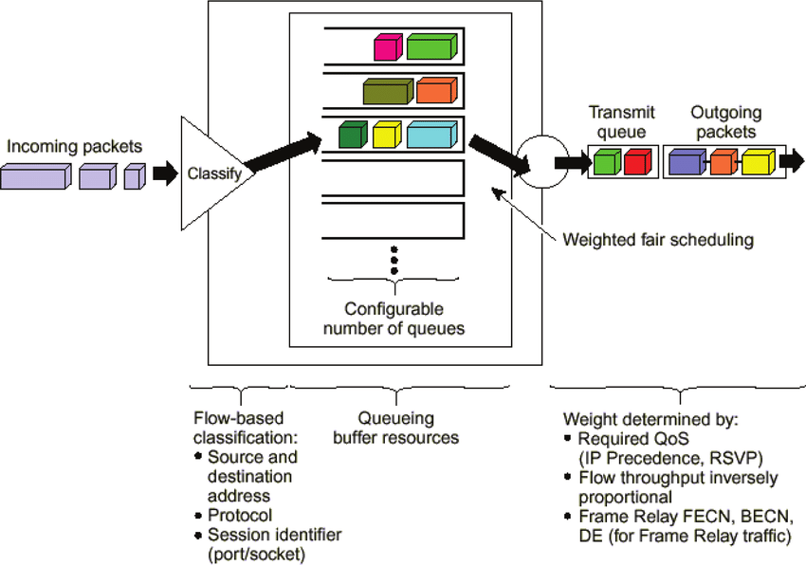
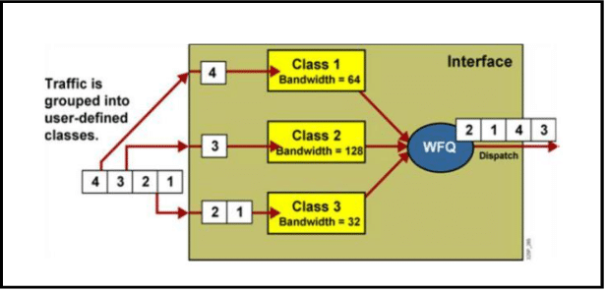
Main QoS Mechanisms
WFQ (Weighted Fair Queuing)
CBWFQ (Class-Based WFQ)
Classification and Marking
Queuing (Scheduling techniques)
Congestion Avoidance
Traffic Policing
Traffic Shaping
Link Efficiency Mechanisms (LEM)

Slide 52
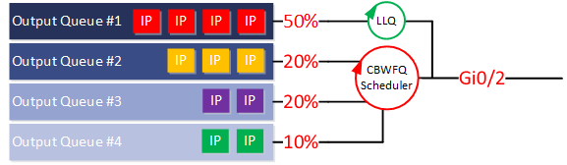
Main QoS Mechanisms
LLQ (Low-Latency Queuing)
Classification and Marking
Queuing (Scheduling techniques)
Congestion Avoidance
Traffic Policing
Traffic Shaping
Link Efficiency Mechanisms (LEM)

Slide 53
Main QoS Mechanisms
Purpose:
Prevent network congestion before it happens by controlling buffer usage and signaling traffic sources to slow down.
How it works:
Routers monitor queue lengths; if queues start filling up, they begin selectively dropping packets rather than waiting for the queue to overflow completely.
Key Mechanisms:
RED (Random Early Detection):
Calculates an average queue size.
If queue exceeds a minimum threshold, packets are dropped randomly.
This acts as an early warning to TCP sources to reduce their sending rate.
WRED (Weighted RED):
Enhanced version of RED.
Uses different thresholds for different classes of traffic (based on DSCP or IP precedence). Example:
High-priority packets dropped later (higher threshold).
Low-priority packets dropped sooner.
Classification and Marking
Queuing (Scheduling techniques)
Congestion Avoidance
Traffic Policing
Traffic Shaping
Link Efficiency Mechanisms (LEM)

Slide 54
Main QoS Mechanisms
Purpose:
Ensure that traffic does not exceed a predefined bandwidth limit. Used for rate enforcement — not smoothing.
How it works:
Based on the Token Bucket Algorithm:
Tokens accumulate in a bucket at a constant rate.
Each packet consumes tokens based on its size.
If enough tokens are available → packet transmitted.
If not → packet is dropped or remarked to a lower priority.
Use cases:
Enforcing Service Level Agreements (SLAs) on customer traffic.
Preventing one flow from monopolizing a link.
Example:
Voice VLAN limited to 1 Mbps. If exceeded, extra packets dropped.
Classification and Marking
Queuing (Scheduling techniques)
Congestion Avoidance
Traffic Policing
Traffic Shaping
Link Efficiency Mechanisms (LEM)

Slide 55
Main QoS Mechanisms
Purpose:
Regulate traffic flow by buffering packets and sending them at a steady rate — smoothing bursts rather than dropping packets.
How it works:
Also based on the Token Bucket model, but instead of dropping packets when tokens are unavailable, shaping delays them in a queue until tokens refill.
Classification and Marking
Queuing (Scheduling techniques)
Congestion Avoidance
Traffic Policing
Traffic Shaping
Link Efficiency Mechanisms (LEM)
Aspect | Policing | Shaping
Excess packets | Dropped or remarked | Buffered and delayed
Goal | Enforce limit | Smooth flow
Best for | Core networks | Edge routers / WAN links

Slide 56
Main QoS Mechanisms
Purpose:
Improve efficiency and reduce delay on low-bandwidth links, such as satellite or remote branch connections.
Techniques:
1. Link Fragmentation and Interleaving (LFI)
Large packets are fragmented into smaller ones.
Small, time-sensitive packets (e.g., voice) are interleaved between fragments.
This reduces delay (serialization delay) for voice packets.
2. Header Compression
Removes redundant header information from IP packets (e.g., in VoIP flows).
Example: cRTP (Compressed Real-Time Transport Protocol) reduces header from 40 bytes → ~2–4 bytes.
3. Payload Compression
Compresses payload data to save bandwidth on low-speed links.
Classification and Marking
Queuing (Scheduling techniques)
Congestion Avoidance
Traffic Policing
Traffic Shaping
Link Efficiency Mechanisms (LEM)

Slide 57
QoS Models
QoS models define how a network manages traffic and provides different service levels to various applications or users. In other words, it is the architectural frameworks or philosophies that define how and where QoS mechanisms are applied across a network.
There are three classical models for implementing QoS:
Best Effort
Integrated Services (IntServ)
Differentiated Services (DiffServ)
Multiprotocol Label Switching (MPLS)
QoS Key Concepts for marking and signaling mechanisms to identify, prioritize, and control traffic across the network.
RSVP (Resource Reservation Protocol)
CoS (Class of Service)
ToS (Type of Service)
DSCP (Differentiated Services Code Point)

Slide 58
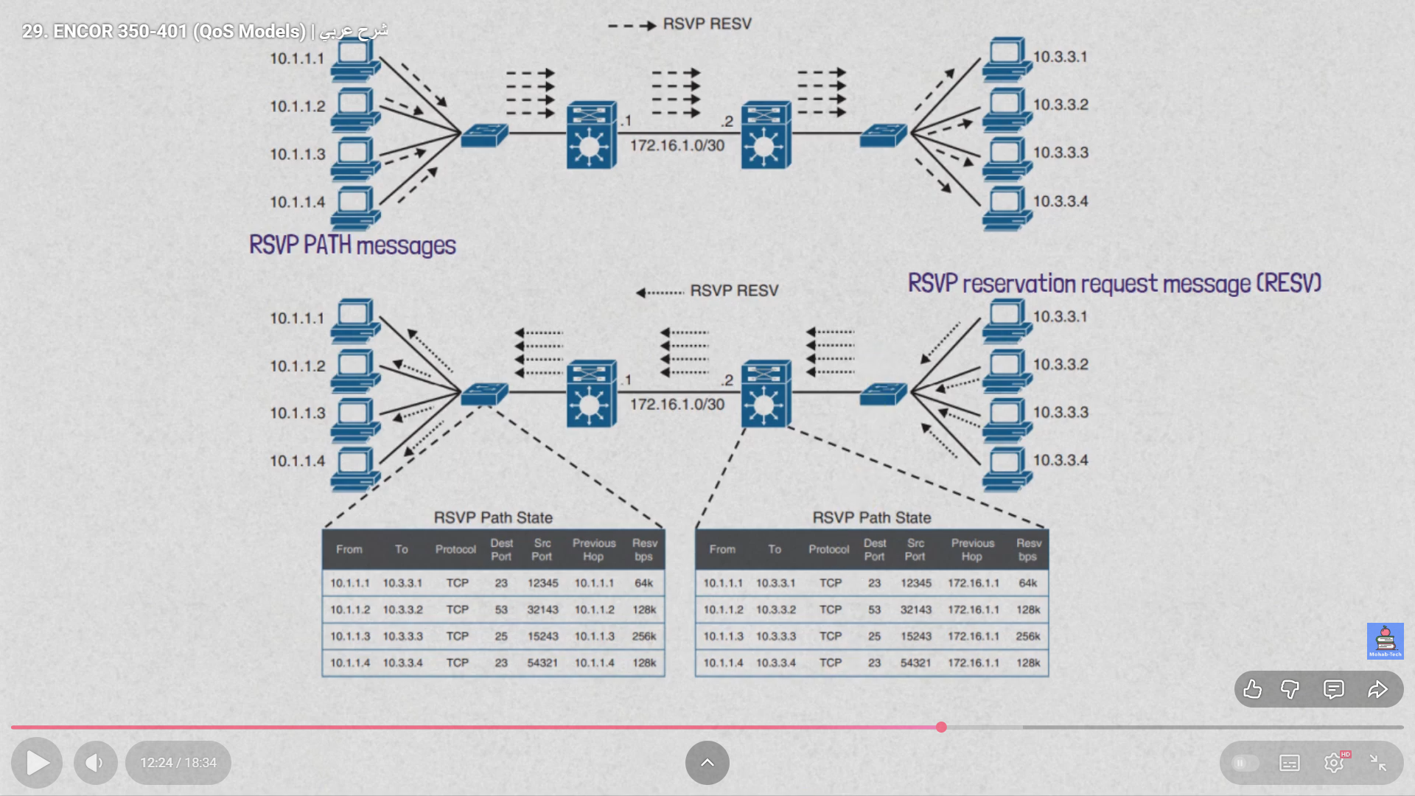
Resource Reservation Protocol (RSVP)
A control protocol used to reserve network resources to provide quality of service (QoS) for real-time applications like video conferencing.

Slide 59
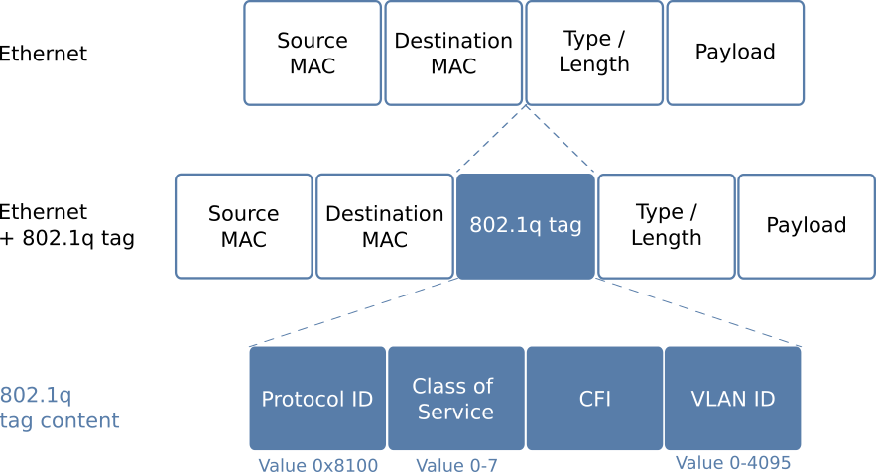
Class of Service (CoS)
Defined in Layer 2 (Data Link Layer) – IEEE 802.1Q VLAN tag.
Uses 3 bits called Priority Code Point (PCP) in the VLAN header → allows 8 priority levels (0–7).
Classifies traffic before it reaches Layer 3 (IP).
Typical values:
6-7 reserved for Network control
5 reserved for Voice over IP (high priority)
0 reserved for Best effort

Slide 60
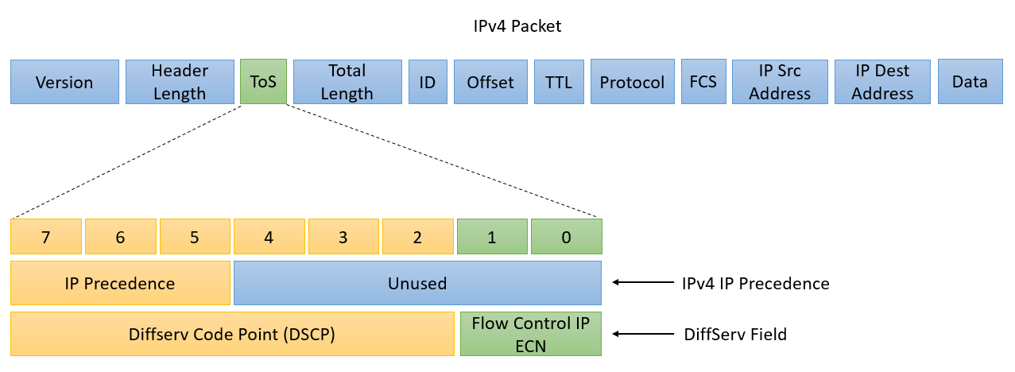
Type of Service (ToS)
Defined in the IPv4 header (8-bit field).
Originally used for prioritizing IP packets by delay, throughput, and reliability.
Structure:
3 bits precedence → IPP
3 bits ToS flags → DSCP
2 bit unused → ECN
Notes:
CISCO allow to creat 11 class of priority, and give us only 3 bit in the ipp ==== creat dscp with 6bit
Ask student about 2^6=64
We have a lot of classes without any reference to prioritise data, router 26 the best priority other do not
IETF Creats 21 preselected values

Slide 61
Differentiated Services Code Point (DSCP)
PHB (Per-Hop Behavior) | Decimal Value | Binary (6 bits)
Default (Best Effort) | 0 | 000000
CS1 (Class Selector 1) | 8 | 001000
CS2 (Class Selector 2) | 16 | 010000
CS3 (Class Selector 3) | 24 | 011000
CS4 (Class Selector 4) | 32 | 100000
CS5 (Class Selector 5) | 40 | 101000
CS6 (Class Selector 6) | 48 | 110000
CS7 (Class Selector 7) | 56 | 111000
EF (Expedited Forwarding) | 46 | 101110

Slide 62
DSCP Assured Forwarding Values
PHB (Per-Hop Behavior) | Description | Decimal Value | Binary (6 bits)
AF11 (Assured Forwarding 1 Low) | Low drop probability | 10 | 001010
AF12 (Assured Forwarding 1 Medium) | Medium drop precedence | 12 | 001100
AF13 (Assured Forwarding 1 High) | High drop precedence | 14 | 001110
AF21 (Assured Forwarding 2 Low) | Higher service class | 18 | 010010
AF22 (Assured Forwarding 2 Medium) | Medium drop precedence | 20 | 010100
AF23 (Assured Forwarding 2 High) | High drop precedence | 22 | 010110
AF31 (Assured Forwarding 3 Low) | Higher reliability traffic | 26 | 011010
AF32 (Assured Forwarding 3 Medium) | Medium drop precedence | 28 | 011100
AF33 (Assured Forwarding 3 High) | High drop precedence | 30 | 011110
AF41 (Assured Forwarding 4 Low) | Premium applications (e.g., video) | 34 | 100010
AF42 (Assured Forwarding 4 Medium) | Medium drop precedence | 36 | 100100
AF43 (Assured Forwarding 4 High) | High drop precedence | 38 | 100110

Slide 63
Best Effort Model (No QoS)
It is the default QoS model used for Internet and it doesn’t implement any QoS mechanism at all, that is the reason why there isn’t any complexity associated to this QoS model.
“send and hope for the best.”
All packets are treated equally; no prioritization or resource reservation.
How It Works
The network forwards packets based on available resources.
If congestion happens, packets are dropped randomly.
Characteristics
Easy to implement.
Low overhead (no QoS setup needed).
No certainty about delay, loss, or throughput.
Performs poorly for real-time traffic (voice, video).

Slide 64
Integrated Services (IntServ)
It’s a model based on flows, i.e., source and destination IP addresses and ports.
applications ask to the network for an explicit resource reservation per flow. Network devices keep track of all the flows traversing the nodes checking if new packets belong to an existing flow and if there are enough network resources available to accept the packet.
The implementation of this model requires the presence of IntServ capable routers in the network and uses RSVP for end-to-end resource reservation. RSVP enables a host to establish a connection over connectionless IP Internet:
Applications request some level of service to the network before sending data.
The network admits or rejects the reservation (per flow) based on available resources.
Once cleared, the network expects the application to remain within the requested traffic profile.
The scalability of this model is limited by the fact that exists a high resource consumption on network nodes caused by per flow processing and associated state. Remember that network nodes need to maintain the reservation state for each flow traversing the node.

Slide 65
Differentiated Services (DiffServ)
Differentiated Services (Diffserv) model is also known as a soft QoS model. It’s a model based in service classes and per hop behaviours associated to each class.
In this case, there is no need for an explicit request for resource reservation by applications to the network. Differentiated Services is based on statistical preferences per traffic class.
DiffServ allows end devices or hosts to classify packets into different treatment categories or Traffic Classes (TC), each of which will receive a different Per-Hop-Behaviour (PHB) at each hop from the source to the destination. Each network device on the path treats packets according to the locally defined PHB.
Priorities are marked in each packet using DSCP for traffic classification. This marking is performed per packet usually at the QoS domain boundary. The marking can be done at several levels of the networking layers (MPLS EXP, CoS).

Slide 66
Emerging Network Technologies
Chapter 04
Objectives: by the end of this chapter, students will be able to:
Understand SDN, NFV, and IoT architectures.
Identify key protocols and control mechanisms.
Explain how these technologies integrate in modern networks.

Slide 67
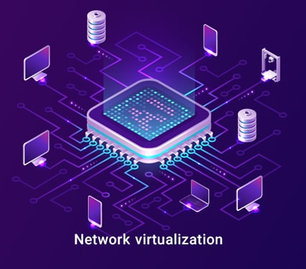
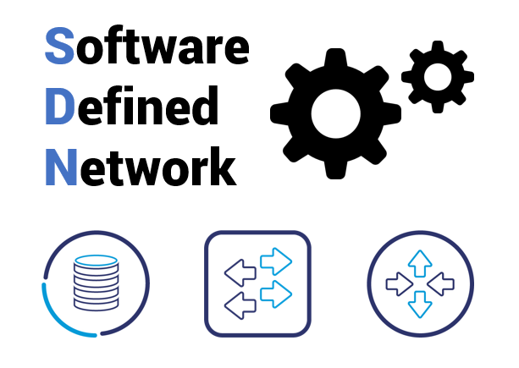

What Are Emerging Network Technologies?
Emerging Network Technologies refer to new and evolving approaches in networking that aim to overcome the limitations of traditional networks — such as rigidity, manual configuration, scalability issues, and lack of automation.
They leverage virtualization, programmability, and intelligence to make networks more flexible, efficient, and adaptable to modern demands like 5G, IoT, and cloud computing.
Traditional networks were designed for fixed infrastructure, limited devices, and predictable traffic. However, today’s networks must handle massive connectivity dynamic services high performance and reliability,To meet these challenges, new paradigms such as:
have emerged to reshape how networks are built, managed, and optimized.

Slide 68
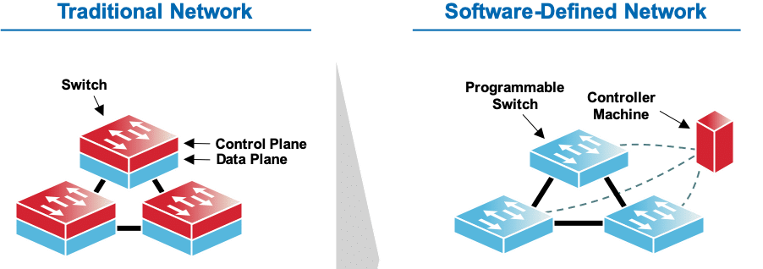
Control plane and data plane
The control plane is the “brain” of the network, it makes decisions about how packets should be handled. In SDN, this plane is centralized in a controller rather than distributed across devices.
The data plane (or forwarding plane) is responsible for moving packets from one interface to another according to pre-defined rules.
Why SDN Separation Matters
Simplifies management: Central control = easier configuration and troubleshooting.
Programmability: Controllers expose APIs to automate network policies.
Flexibility: Network behavior can change dynamically (e.g., prioritizing video traffic).
Security: Central view allows for rapid detection and mitigation of attacks.

Slide 69
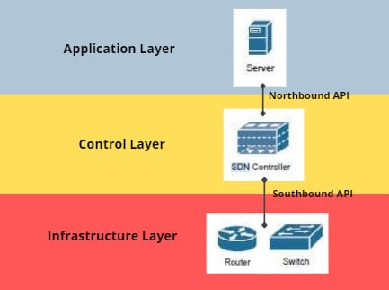
Software-Defined Networking (SDN)
SDN separates the control plane (decision-making) from the data plane (packet forwarding). This separation enables centralized control, automation, and programmable management of the network.
Traditional vs. SDN Network:
Traditional: Each device (router/switch) makes its own decisions.
SDN: A central controller dictates forwarding rules for all devices.
Key Components:
Application Layer – Network applications (firewall apps, load balancers).
Control Layer – SDN controller (e.g., OpenDaylight, ONOS).
Infrastructure Layer – Physical/virtual switches and routers.

Slide 70
Why SDN?
Limitations of Traditional Networking:
Complex and error-prone configuration.
Vendor lock-in (proprietary hardware and software).
Slow adaptation to new policies or security requirements.
SDN Advantages:
Centralized management via software controllers.
Programmability: networks can be configured through APIs.
Agility: quick deployment of new services.
Automation: reduces manual errors.

Slide 71
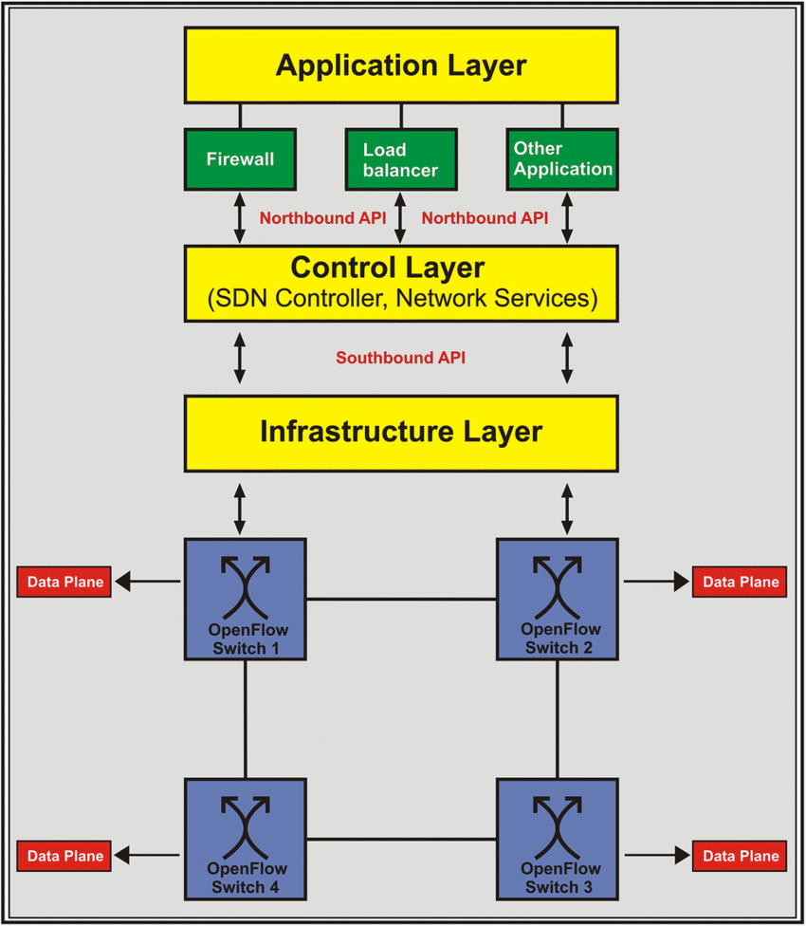
SDN Architecture (3-Layer Model)
Application Layer
Contains network applications (e.g., load balancing, firewalls, routing).
Communicates with the controller via Northbound APIs.
Control Layer
The SDN Controller acts as the network’s “brain.”
Uses Southbound APIs (like OpenFlow) to communicate with devices.
Infrastructure Layer
Physical and virtual switches and routers (the data plane).
Responsible for packet forwarding based on flow rules.

Slide 72
SDN Infrastructure Layer
Role: Execute the instructions from the controller (forward, drop, modify, send).
Components:
OpenFlow Switches: Hardware or software-based devices that understand controller instructions.
Flow Tables: Contain match–action rules (if packet matches criteria → perform action).
Virtual Switches (vSwitch): Run in hypervisors or cloud environments (e.g., Open vSwitch).
Protocol Example: OpenFlow, NETCONF, gNMI.

Slide 73
SDN Control Plane (The Controller)
Function: Central point that determines how traffic flows in the network.
Tasks:
Maintains network topology.
Installs, updates, or removes flow rules.
Collects statistics from switches.
Enforces policies (QoS, access control, routing).
Examples:
ONOS (Open Network Operating System)
OpenDaylight
Floodlight, Ryu, Cisco APIC

Slide 74
SDN Application Layer
Purpose: Provides user-facing functionality that defines network behavior.
Common SDN Applications:
Traffic Engineering: Optimize bandwidth usage.
Security Monitoring: Intrusion detection, anomaly detection.
Load Balancing: Distribute flows across multiple paths.
QoS Management: Prioritize delay-sensitive traffic.
Interface: Communicates with the controller via Northbound APIs (usually RESTful APIs).

Slide 75
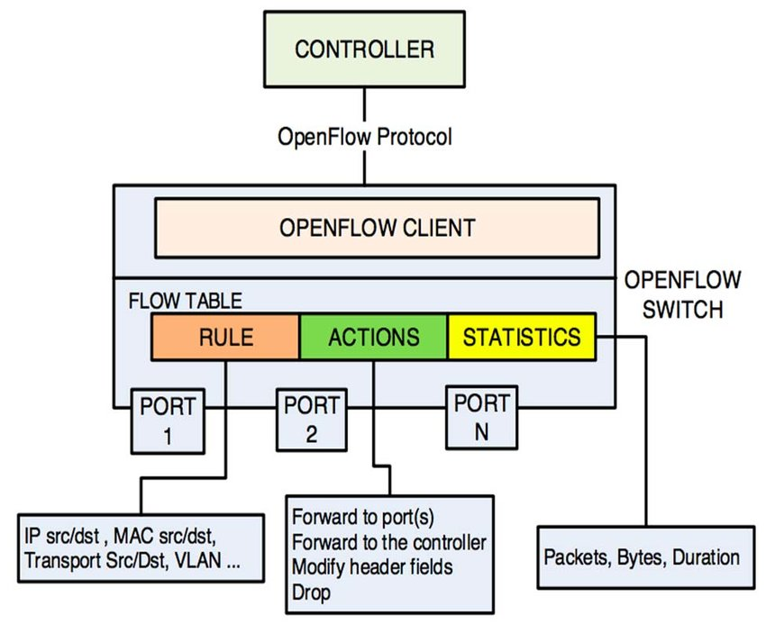
OpenFlow Protocol (Southbound Interface)
OpenFlow is the first and most widely used SDN protocol that defines communication between the controller and forwarding devices.
How it Works:
Controller installs flow entries into switches.
Each entry includes:
Match fields (IP, MAC, VLAN, TCP port).
Actions (forward, drop, modify, send to controller).
Counters (statistics).
OpenFlow Messages:
Packet-In: Switch → Controller (no matching rule found).
Flow-Mod: Controller → Switch (install or delete a flow rule).
Packet-Out: Controller → Switch (send specific packet).
Stats-Request/Reply: For monitoring traffic flows.

Slide 76
Flow Table Operation
Flow Entry Example:
Match Field | Action | Priority
IP src = 192.168.1.10 | Forward to port 3 | 10
TCP dst = 80 | Forward to port 2 | 5
Any | Send to controller | 1
The process:
Packet arrives → matched against flow entries.
Matching action executed.
If no match → packet sent to controller for decision.

